Slide 1
Team Building

Slide 2
Brainstorm: to try to solve a problem by talking with other people : to discuss a problem and
suggest solutions,
Fig. Rules for Brainstorming

Slide 3
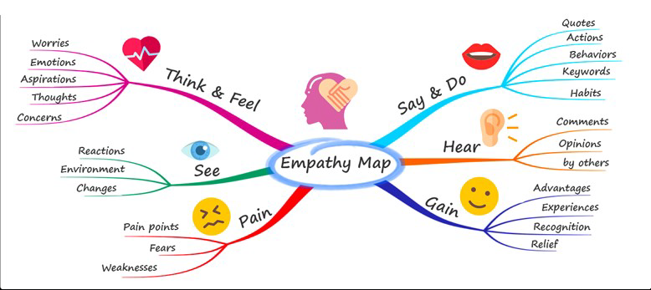
Fig 1.2 Mind Mapping
Mind Mapping
A mind map is an image that contains any sort of graphical element to express an idea,

Slide 4
Brain writing
6-3-5 Six people sit in a table to write 3 ideas in 5 minutes. To write down their ideas about a
particular question or problem on sheets

Slide 5
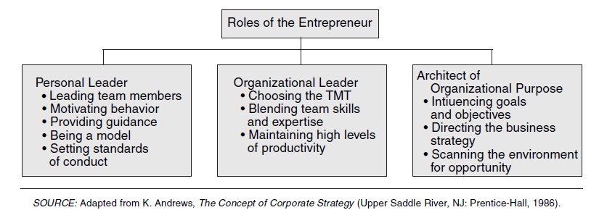
Roles of the Entrepreneur as General Manager
Notes:
TMT= Top Management Team

Slide 6
Pitching to candidates to join your startup is a crucial step in attracting the right talent.
Understand Your Target Candidates: Before you start pitching, you need to know your audience. Understand the skills, experience, and qualities you're looking for in a candidate. Tailor your pitch to address their specific needs and motivations.
Craft a Compelling Value Proposition: What makes your startup special? What unique benefits can you offer to candidates? Your value proposition should highlight factors like the opportunity for growth, the chance to make an impact, a dynamic work environment, and any other perks or benefits you can offer.
Clear and Compelling Job Description: Write a job description that clearly outlines the responsibilities, expectations, and potential for career advancement. Be specific about the role and its importance in the company's success.
Tell Your Startup's Story: Every startup has a unique story. Share your journey, the mission and vision of the company, and the problems you're trying to solve. This creates an emotional connection with candidates and helps them understand the bigger picture.

Slide 7
Pitching to candidates to join your startup is a crucial step in attracting the right talent.
Highlight the Learning Opportunities: Startups are excellent places for personal and professional growth. Emphasize the chance to work on challenging projects, learn new skills, and take on responsibilities that might not be available in larger organizations.
Culture and Work Environment: Describe your company's culture and work environment. Is it a collaborative, flexible, or innovative space? Candidates want to know if they'll enjoy coming to work every day.
Show the Impact They Can Make: Explain how their role will contribute to the company's success and the broader impact it can have on the industry or society.
Benefits and Perks: Discuss the benefits and perks you offer, such as flexible work hours, remote work options, equity or stock options, healthcare, or other unique benefits.
Mentorship and Leadership Opportunities: Highlight any opportunities for mentorship, leadership, or career advancement within the startup.

Slide 8
Pitching to candidates to join your startup is a crucial step in attracting the right talent.
Transparency and Communication: Be open about the company's challenges and the steps you're taking to address them. Candidates appreciate honesty and transparency.
Address Concerns: Be prepared to address common concerns such as job security, work-life balance, and compensation. Explain how your startup addresses these issues.
Offer a Vision for the Future: Share your vision for the company's growth and the candidate's potential role in that growth. Help them see a long-term future with your startup.
Engage in Two-Way Conversations: Encourage candidates to ask questions and share their thoughts. It should be a dialogue, not just a one-sided pitch.
Follow-Up and Personalize: After the initial pitch, follow up with personalized messages to express your continued interest in the candidate and the role.
Be Authentic: Authenticity is key. Be yourself and let candidates see the real people behind the startup.
Remember that the recruitment process is a two-way street. You want to attract candidates who are not only a good fit for your startup but also candidates who believe in your mission and vision.

Slide 9
A good team is essential for the success of any entrepreneurial venture.
Diverse Skill Sets: A good team typically consists of individuals with diverse skills and expertise. This diversity can fill in the gaps and ensure that all necessary functions of the business, from product development to marketing to finance, are well-covered.
Innovation and Creativity: A diverse team often brings a variety of perspectives and approaches to problem-solving. This can lead to greater innovation and creativity, helping the startup come up with unique solutions and ideas.
Execution and Implementation: Ideas are only valuable when they are executed effectively. A good team is responsible for turning the vision and strategy into actionable plans and implementing them efficiently.
Risk Mitigation: Entrepreneurship is inherently risky. A good team can help in identifying, evaluating, and mitigating risks. The collective experience and knowledge of the team can help make better-informed decisions.
Support and Motivation: Entrepreneurship can be a challenging journey with highs and lows. A good team provides emotional support and motivation during tough times. The team's camaraderie can keep everyone motivated and focused on the long-term goals.

Slide 10
A good team is essential for the success of any entrepreneurial venture.
Accountability: A strong team promotes accountability. Team members can hold each other responsible for their respective roles and responsibilities, ensuring that everyone is contributing to the best of their abilities.
Customer Focus: A good team understands the needs of the customers and is focused on delivering value to them. This customer-centric approach is crucial for building a successful business.
Scalability: As the startup grows, the team can adapt and scale with the business. A well-structured team can handle growth and expansion more effectively than a one-person operation.
Adaptability: In the dynamic and ever-changing world of entrepreneurship, adaptability is key. A good team can pivot, adjust strategies, and navigate changes more effectively than a single founder.
Credibility: Having a strong team can enhance the credibility of the startup in the eyes of investors, customers, and partners. It demonstrates that the venture is not a one-person show but a collective effort.
Mentorship and Learning: Team members can mentor and learn from each other, fostering personal and professional growth within the team.
A good team is the backbone of a successful entrepreneurial venture. It provides the skills, diversity, support, and resources needed to overcome challenges and capitalize on opportunities.

Slide 11
key principles of setting up the right team of employees for the startup at all stages
Setting up the right team of employees for a startup is crucial for its success. Here are key principles to consider at each stage - recruitment, training, team building, and promotion/termination:
1. Recruitment:
a. Cultural Fit:
Principle: Prioritize cultural fit alongside skills. Ensure alignment with the startup's values, vision, and work culture.
Reasoning: A cohesive team shares common goals and values, fostering a positive and collaborative work environment.
b. Diversity and Skill Set:
Principle: Assemble a diverse team with complementary skills.
Reasoning: Diverse perspectives and skills enhance creativity, problem-solving, and adaptability, key for startup growth.
c. Passion for Startup Mission:
Principle: Recruit individuals passionate about the startup's mission.
Reasoning: Passion drives dedication and a sense of ownership, essential for overcoming challenges in the startup environment.

Slide 12
key principles of setting up the right team of employees for the startup at all stages
2. Training:
a. Continuous Learning:
Principle: Prioritize continuous learning and skill development.
Reasoning: Startups evolve rapidly; a learning culture ensures the team stays adaptable and equipped with the latest skills.
b. Cross-Functional Training:
Principle: Encourage cross-functional training to broaden skills.
Reasoning: Cross-functional skills enable team members to contribute beyond their specific roles, promoting versatility.
c. Mentorship Programs:
Principle: Establish mentorship programs for new hires.
Reasoning: Mentoring accelerates onboarding, helps navigate the startup environment, and fosters a sense of belonging.
3. Team Building:
a. Open Communication:
Principle: Foster open and transparent communication.
Reasoning: Open communication builds trust, resolves conflicts efficiently, and encourages idea sharing.
b. Team Bonding Activities:
Principle: Organize team-building activities.
Reasoning: Activities outside work enhance team cohesion, creating a positive and collaborative atmosphere.
c. Recognition and Rewards:
Principle: Recognize and reward achievements.
Reasoning: Acknowledgment boosts morale, motivates employees, and reinforces a culture of excellence.

Slide 13
key principles of setting up the right team of employees for the startup at all stages
4. Promotion/Firing:
a. Performance-Based Promotions:
Principle: Base promotions on performance and contributions.
Reasoning: Performance-based promotions motivate employees, demonstrating that hard work is valued.
b. Constructive Feedback:
Principle: Provide constructive feedback for improvement.
Reasoning: Regular feedback, both positive and constructive, guides development and addresses performance issues.
c. Fair and Transparent Processes:
Principle: Ensure fairness and transparency in promotion and termination processes.
Reasoning: Fairness builds trust, and transparency reduces uncertainty, fostering a healthy workplace culture.
d. Timely Termination for Misalignment:
Principle: Terminate employees promptly if misalignment persists.
Reasoning: Timely action prevents negative impacts on team morale and the startup's overall performance.
Conclusion:
Establishing the right team involves aligning values, fostering continuous learning, and creating an inclusive, collaborative culture. Regular assessments and adjustments ensure the team remains adaptable and supportive of the startup's mission at every stage of growth.

Slide 14
•The role, types and features of remote team collaboration tools.
Remote team collaboration tools play a crucial role in enabling effective communication, coordination, and collaboration among team members who are geographically dispersed. These tools are essential for remote or distributed teams to work together seamlessly. Here's an overview of their role, types, and features:
Role of Remote Team Collaboration Tools:
Facilitate Communication:
Enable real-time communication and messaging.
Provide channels for team discussions and updates.
Support video and voice calls to enhance virtual meetings.
Enhance Collaboration:
Enable shared document editing and collaboration on projects.
Facilitate file sharing for seamless information exchange.
Support project management and task tracking.
Promote Transparency:
Provide visibility into team members' activities and progress.
Ensure access to shared calendars, schedules, and project timelines.

Slide 15
•The role, types and features of remote team collaboration tools.
Improve Productivity:
Streamline workflow and task management.
Integrate with other productivity tools for a unified experience.
Facilitate remote access to essential resources.
Foster Team Bonding:
Incorporate features for virtual team building and social interaction.
Create channels for non-work-related discussions and celebrations.
Types of Remote Team Collaboration Tools:
Communication Tools:
Examples: Slack, Microsoft Teams, Discord.
Features: Real-time messaging, channels, video conferencing.
Project Management Tools:
Examples: Trello, Asana, Jira.
Features: Task assignment, progress tracking, project timelines.

Slide 16
The role, types and features of remote team collaboration tools.
File Sharing and Storage Tools:
Examples: Google Drive, Dropbox, Microsoft OneDrive.
Features: Secure file storage, version control, document sharing.
Video Conferencing Tools:
Examples: Zoom, Microsoft Teams, Google Meet.
Features: Video calls, screen sharing, virtual backgrounds.
Collaborative Editing Tools:
Examples: Google Workspace, Microsoft 365.
Features: Real-time document editing, collaboration on files.
Task Management Tools:
Examples: Todoist, Wrike, Monday.com.
Features: Task creation, assignment, deadlines.

Slide 17
The role, types and features of remote team collaboration tools.
Time Tracking Tools:
Examples: Toggl, Harvest, Clockify.
Features: Time tracking, reporting, invoicing.
Virtual Whiteboard Tools:
Examples: Miro, MURAL, Microsoft Whiteboard.
Features: Digital whiteboard, collaborative brainstorming.
Features of Remote Team Collaboration Tools:
User-Friendly Interface:
Intuitive design for easy navigation and usage.
Cross-Platform Compatibility:
Support for various devices and operating systems.
Integration Capabilities:
Compatibility with other tools and software for seamless workflows.
Security and Privacy:
Robust security measures to protect sensitive data.

Slide 18
The role, types and features of remote team collaboration tools.
Notification and Alerts:
Alerts for updates, messages, and approaching deadlines.
Customization Options:
Ability to tailor the tool to the team's specific needs.
Scalability:
Ability to grow and adapt as the team and projects expand.
Collaboration Analytics:
Insights into team collaboration patterns and productivity.
Remote team collaboration tools, when chosen and implemented strategically, play a pivotal role in overcoming the challenges of working in a distributed environment and fostering effective teamwork.

Slide 19
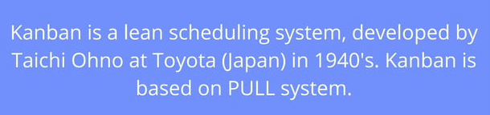
Kanban Board

Slide 20
How Kanban Works
Why Kanban Boards

Slide 21
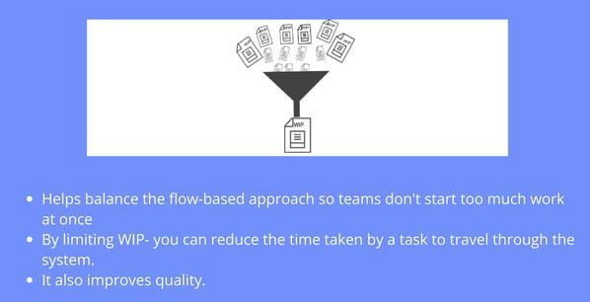
1 Visualise Work
2 Limit Work in Progress (WIP)

Slide 22
3 Focus on Flow
4 Continuous Improvement

Slide 23
How to start with Kanban Board

Slide 24
Map your workflow
Visualize Work in Progress

Slide 25
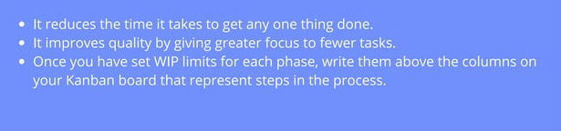
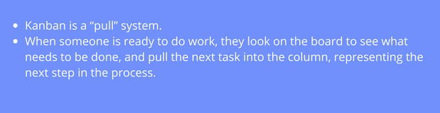

Set your initial WIP limits
Get Kanban Working
Inspect and Adapt

Slide 26
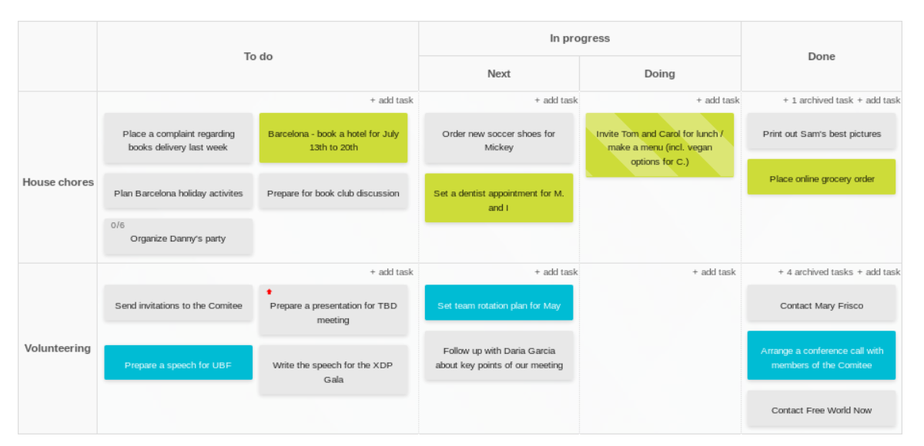
Basic Kanban Board

